Slide 1
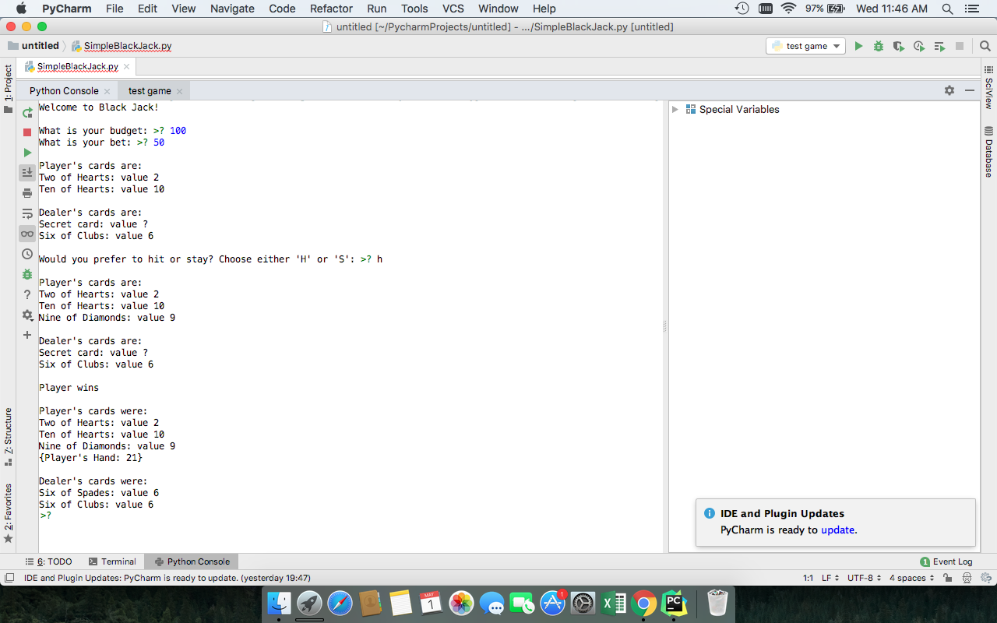
Simple Black Jack Game
Project by: Mason Dozier
This is a simple version of the classic casino game Black Jack. This program was written in python and works through the command line. The object is to have your cards add up to 21 or be closer to 21 than the dealer. Face cards are worth 10, Number cards are worth the same amount as their number, and Aces can be worth either 11 or 1. Users choose their budget and wager amounts. Play until you run out of money or chose to leave.

